Slide 1


Big Data & Analytics Solution Proposal
Skynet
March 2017

Slide 2
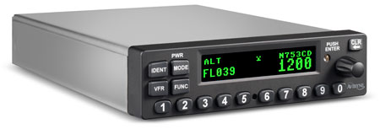


Introduction
Why are we here?
Skynet has reached Think Big for the following concrete business needs:
To identify 2+ aircraft types to certify ADS-B transponders to
Provide market information to support building the business case, potential customers (airlines), and addressable market
To support analyzing how to further monetize that information
Creating the business case analysis structure for other use cases as, for instance, to identify flight delay information that can be sold to interested third parties

Slide 3
Introduction
Who we are?
Why Think Big?
200+ successfull engagements all over the world
Business acumen
Technology experts
Open source technologies
Think Big is an
independent
pure-play
big data
services company

Slide 4
Use Cases Definitions
1-on-1’s with senior leaders to discuss business imperatives
Identify overall list of use cases and business value
Finalize scoring and ranking of use cases
Review required and available data sources
Review initial recommendations

Slide 5
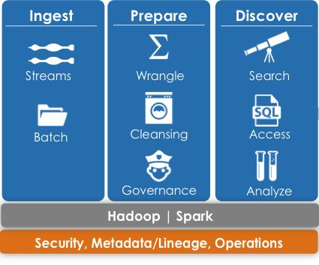
Solution Definition
Overview
Adopt an efficient and flexible architecture for a successful Discovery product.
Use Kylo, the open-source technology developed by ThinkBig, to ingest and curate the data.
The data sources to be loaded into Hadoop are: Federal Aviation Administration dataset, Flight Aware data and internally collected ADS-B sample set.
Adopt best practice governance and security methods.

Slide 6
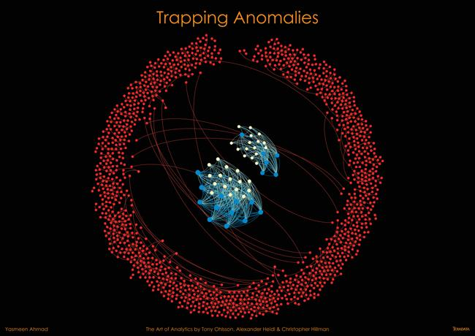
Solution
Transponder Sales
Hive/Spark to identify the top 2 aircraft types that do not have ADS-B transponders along with additional details regarding airline ownership through the web application to support transponder sales.
Flight Delay prediction
Spark to Discover business value for flight delay predictions using Advanced Data Science methods. Use FlightAware, aircraft/airline/airport specific characteristics and weather related data to develop and test flight delay prediction models.
Aircraft
Geography
Time
Weather

Slide 7
Think Big Staffing Project Focus Areas
Phase 1: Use Case definition | Phase 2: Solution Design & Analysis
© 2016 Think Big, A Teradata Company
Notes:
1-on-1’s with senior leaders to discuss business imperatives
Identify overall list of use cases and business value
Finalize scoring and ranking of use cases
Review initial recommendations
Use Kylo to ingest and curate the data.
Load the data into Hadoop
Adopt best practice governance and security methods.
Review required and available data sources
Analyse the data

Slide 8
Think Big Staffing Project Focus Areas
 | Phase 1: Use Case definition
Activity | 1-on-1’s with senior leaders to discuss business imperatives Identify overall list of use cases and business value Finalize scoring and ranking of use cases Review initial recommendations
Deliverables | Define use cases and data required
Staff & Time | 1 Delivery Lead 1 Senior Data Engineer and 1 Senior Data Scientist 1 Week
© 2016 Think Big, A Teradata Company
Notes:
1-on-1’s with senior leaders to discuss business imperatives
Identify overall list of use cases and business value
Finalize scoring and ranking of use cases
Review initial recommendations
Use Kylo to ingest and curate the data.
Load the data into Hadoop
Adopt best practice governance and security methods.
Review required and available data sources
Analyse the data

Slide 9
Think Big Staffing Project Focus Areas
 | Phase 1: Use Case definition | Phase 2: Solution Design & Analysis
Activity | 1-on-1’s with senior leaders to discuss business imperatives Identify overall list of use cases and business value Finalize scoring and ranking of use cases Review initial recommendations | Use Kylo to ingest and curate the data. Load the data into Hadoop Adopt best practice governance and security methods. Review required and available data sources Analyse the data
Deliverables | Define use cases and data required | High Level Solution Design Sufficient information to progress with Use Case(s) Business Advice regarding transporters sales
Staff & Time | 1 Delivery Lead 1 Senior Data Engineer and 1 Senior Data Scientist 1 Week | 50% Delivery Lead 2 Senior Data Engineer and 1 Senior Data Scientist 6 Weeks
© 2016 Think Big, A Teradata Company
Notes:
1-on-1’s with senior leaders to discuss business imperatives
Identify overall list of use cases and business value
Finalize scoring and ranking of use cases
Review initial recommendations
Use Kylo to ingest and curate the data.
Load the data into Hadoop
Adopt best practice governance and security methods.
Review required and available data sources
Analyse the data

Slide 10
Think Big Summary of Costs
Costs of the Services: $170,000
Offshore Ongoing Pipeline Development (TBD)
Example: Flight delay prediction

